Slide 1
PEER - Bulgaria
Dublin, 4th Nov., 2016

Slide 3
DUPNITSA

Slide 4
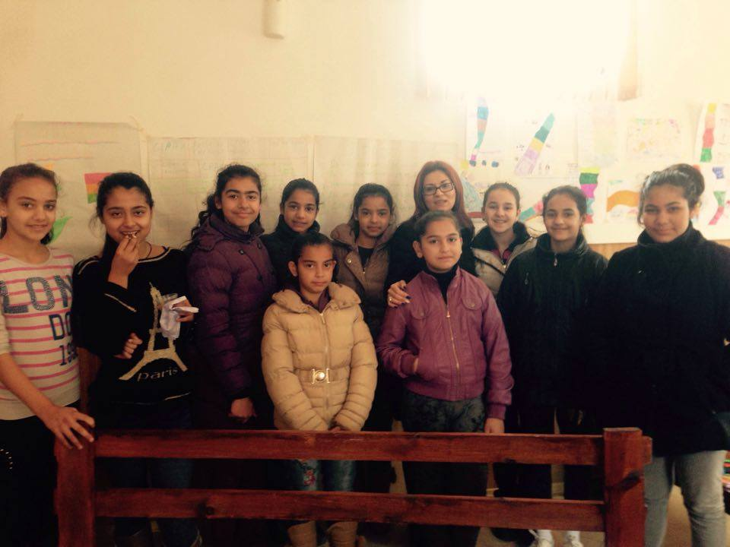
The VIOLETS

Slide 5
“The Violets” – the girls that never had a voice about the issues that concern them
Girls felt free to talk about sensitive issues, because:
they were in a single-gender group, and
had women facilitators who more easily created a trustful atmosphere
girls come from a very similar background (all Roma, from one suburb, from one school, families with similar SES and education); the group was quite homogenous
their age of 12 is usually crucial in life of a young Roma girls in the transition from childhood directly into the roles of the adults (wife, mother).

Slide 6
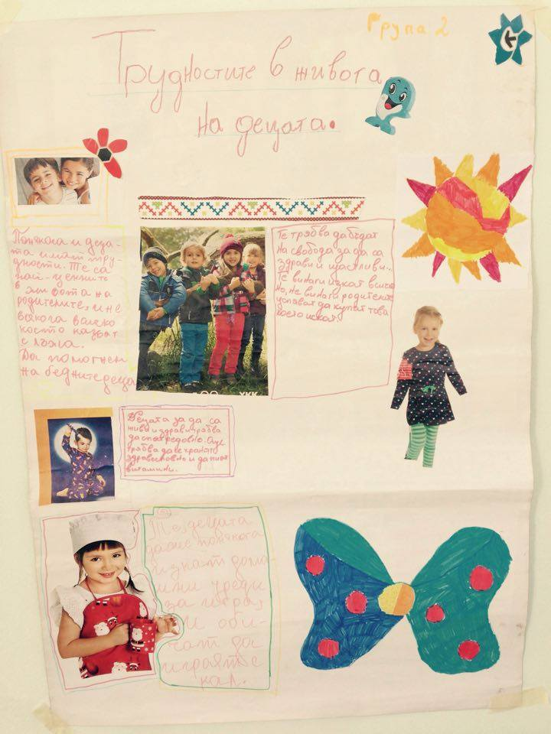
The difficulties in children’s lives:
Poverty
Communication with parents
Who listens to their opinions
Are there adults who will play with them

Slide 7
Difficulties in th elives of the girls:
Fear
Shame
Violence at home and at school
Lack of courage

Slide 8
using an exercise which aimed at opening a space for sharing personal stories (namely, “River of life”) made it possible to raise sensitive issues concerning young Roma girls. It was a groundbreaking point when they reached the moment of “present” in the “river of life” because it opened the question about the near future. What the girls shared was that usually soon after the age of 12 girls in the community are expected to get married. This is a traditional value enforced by parents, community and leaders (incl. religious ones). Girls are hardly perceived to have any other opportunities in life.

Slide 9
The issues the girls raised
gender – what it is to be a girl at the age of 12 when soon you are expected to get married – the future is predictable, it is decided and it has been like that for generations; family teaches that this is the norm and a girl cannot go against their family
gender-based violence is normal in the community; if a woman suffers it is her fault and it is her to be blamed for the problems in the family
sexual issues – girls are forced by their families to enter into adult relationships including sexual

Slide 11
Ideas how we can work on their issues, with whom
The girls joined around the idea of helping one of their peers (with whom they most probably identify themselves). They called her Bo. They shared Bo’s story – Bo cannot oppose her father, he has promised to marry her to a certain boy. The boy already treats her as if he is in control. There is domestic violence in her home. The girls formulated the situation of their classmate Bo as: being lonely, feeling sorrow, have fears, have problems at school because of that, staying silent being depressed because of the violence at home.

Slide 12
Ideas how we can work on their issues, with whom
They generated ideas how they can help a girl in a situation like this:
turn to the class teacher and ask her to support Bo at school when she is harassed by the boy
invite a psychologist at school to talk to the young people
be friends for Bo and invite her to share her concerns
go as a group to Bo’s parents and try make them understand her situation
have children’s police
go and talk to the boy who threatens Bo and threaten him

Slide 13
Participation means having a Cause
For the girls in Dupnitsa the cause became learning how to help other girls who are in need of protection. Again, the key role was of the partner NGOs that deals with gender issues and issues of violence. They invited the girls in their Youth club – a group of 20 young people that gather together on regular basis every Friday in the office. It is part of the violence prevention program of the NGO and young people there do peer-to-peer awareness raising activities, they learn about the forms of violence and discuss age-sensitive issues like healthy relations, being part of a couple, abusive relationships, how to provide support, where to refer peers who have experienced violence…

Slide 14
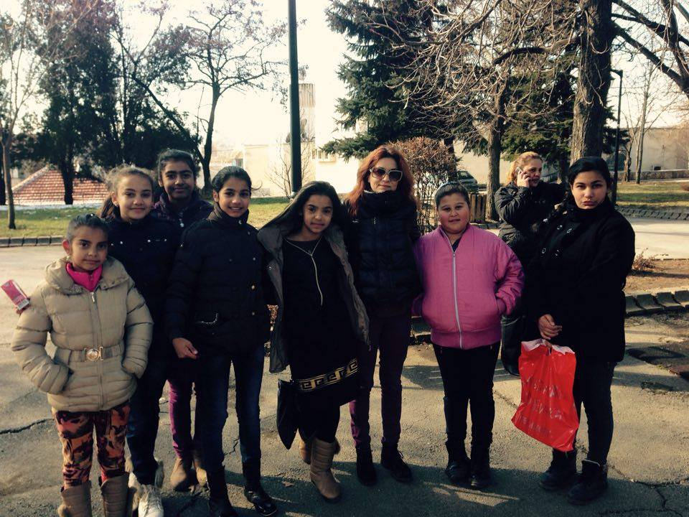
THANK YOU FOR YOUR ATTENTION!!!!!!!
The Violets ☺

